Slide 1
MD5 and Collision Resistance
Created By: Jack Bowman

Slide 2
Overview
Hash Function Review
Collision Attack Types
MD5 Analysis
Identical-Prefix Attack Demonstration
Practical takeaways

Slide 3
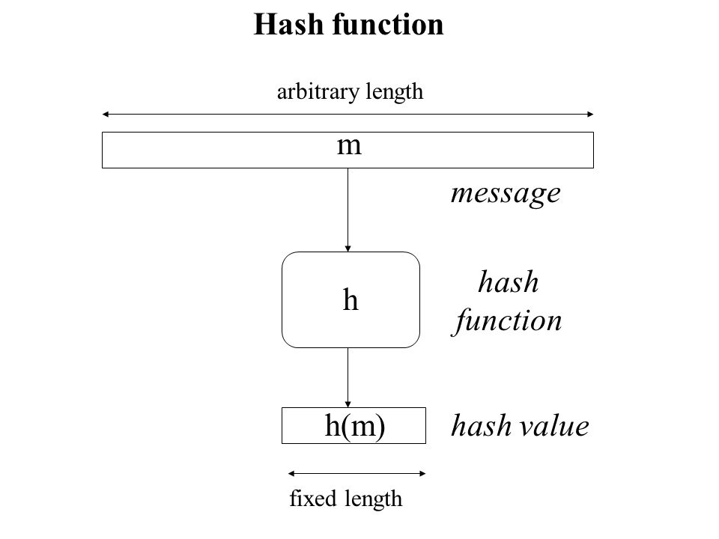
Introduction

Slide 4
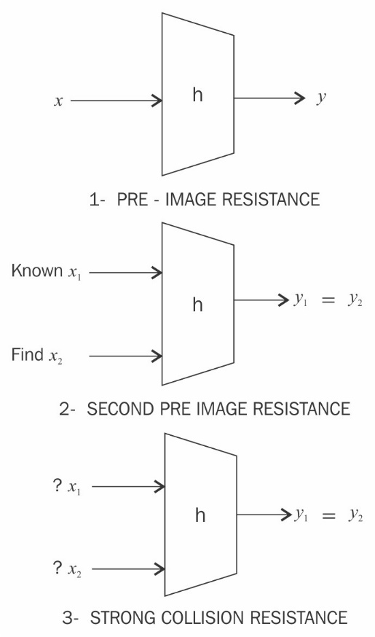
Introduction Cont.
Preimage Resistance
Second Preimage Resistance
Collision-Resistance

Slide 5
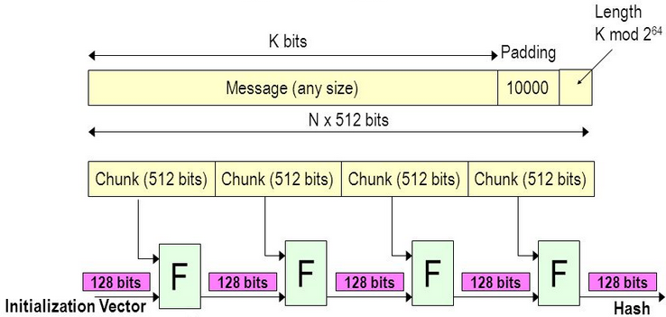
MD5 Algorithm
512-bit Blocks
One-Way Function
Iterative Process
Every Block Contributes to the hashes final 128-bit value
Important Property…

Slide 6
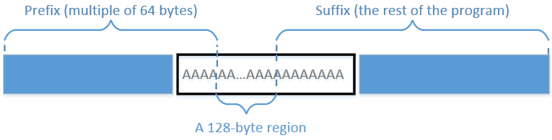
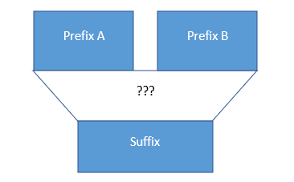
Collision Attacks
Identical-Prefix Attack
Chosen-Prefix Attack

Slide 7
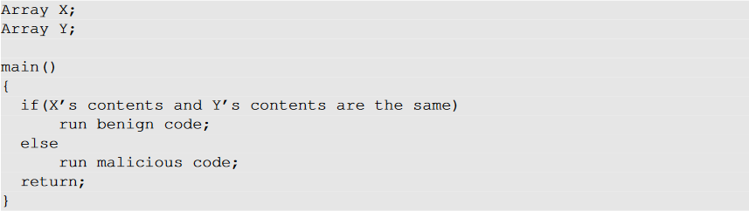
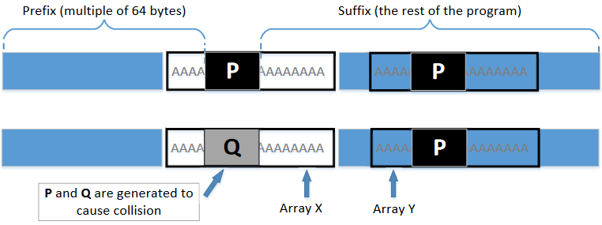
Demonstration
Notes:
CMD SEQUENCE
01> nano program.c
02> gcc program.c -o program
03> bless program
04> head -c 12352 program > prefix
05> ../scripts/poc_no.sh prefix
06> tail -c 128 collision1.bin > p
07> tail -c 128 collision2.bin > q
08> tail -c +12481 program > suffix
09> head -c 192 suffix > suffix1
10> tail -c +321 suffix > suffix2
11> cat prefix p suffix1 p suffix2 > benignEXE
12> chmod +x benignEXE
13> cat prefix q suffix1 p suffix2 > maliciousEXE
14> chmod +x maliciousEXE
15> md5sum benignEXE maliciousEXE
16> ./benignEXE
17> ./maliciousEXE

Slide 8
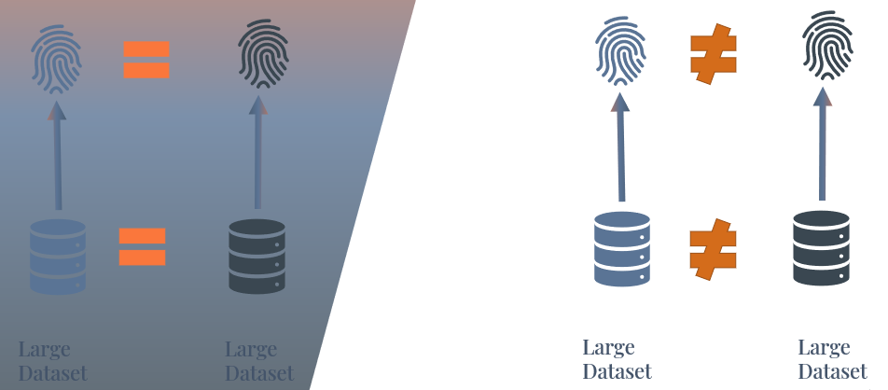
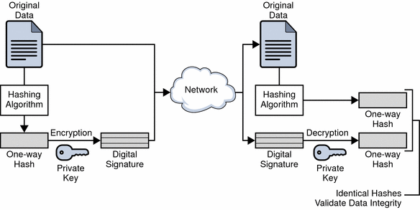
Practical Takeaways
MD5 Has Its Purpose
Should Not Be Used For Confidential Information

Slide 9
Summary
Hash Function Review
Collision Attack Types
MD5 Analysis
Identical-Prefix Attack Demonstration
Practical takeaways

Slide 10
Image References
https://slideplayer.com/slide/6223815/
https://www.oreilly.com/library/view/mastering-blockchain/9781788839044/97f1fbf0-965b-4c5d-9f07-e6e20fb78bd0.xhtml
https://docs.oracle.com/cd/E19693-01/819-0997/auto26/index.html
https://seedsecuritylabs.org/Labs_16.04/PDF/Crypto_MD5_Collision.pdf
https://www.stick2tech.com/post/hash-code
https://upscfever.com/upsc-fever/en/gatecse/gateppr/gateppr16/en-gateppr-chp16.html

